Slide 1
Tensor flow

Slide 2
TensorFlow is an end-to-end platform for machine learning. It supports the following:
  Multidimensional-array based numeric computation
  GPU and distributed processing
  Automatic differentiation
  Model construction, training, and export

Slide 3
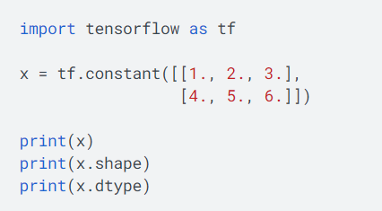
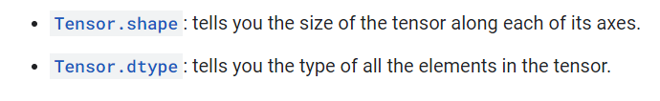
Tensors
TensorFlow operates on multidimensional arrays or tensors represented as tf.Tensor objects. Here is a two-dimensional tensor:

Slide 4

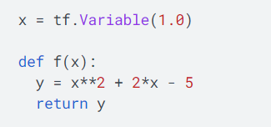
Variables
Automatic differentiation
Typically you'll use this to calculate the gradient of a model's error or loss with respect to its weights.

Slide 5
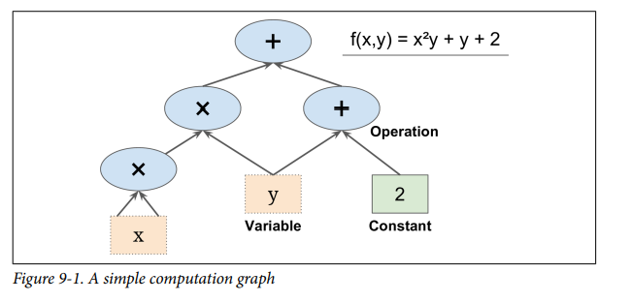
TensorFlow is a powerful open source software library for numerical computation, particularly well suited and fine-tuned for large-scale Machine Learning.

Slide 6
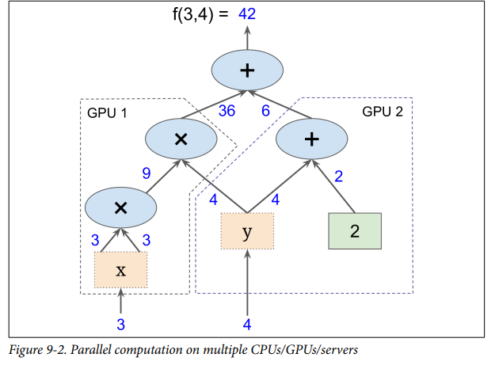
it is possible to break up the graph into several chunks and run them in parallel across multiple CPUs or GPUs (as shown in Figure 9-2).

Slide 7
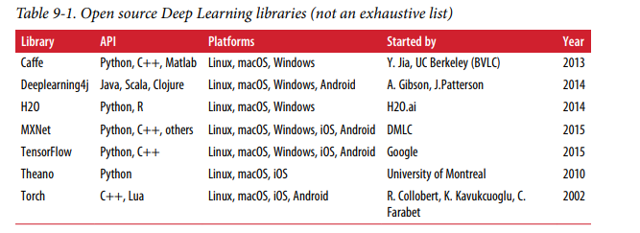

Slide 8
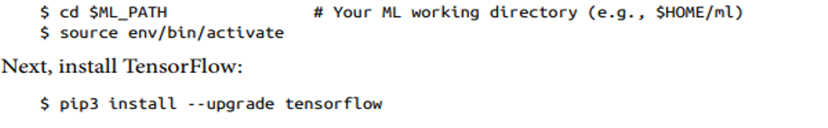

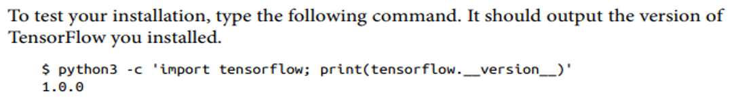
Installation

Slide 9
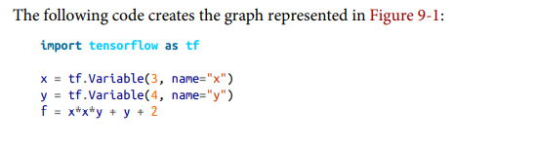
Creating Your First Graph and Running It in a Session

Slide 10
It just creates a computation graph. In fact, even the variables are not initialized yet.
To evaluate this graph, you need to open a TensorFlow session and use it to initialize the variables and evaluate f.
A TensorFlow session takes care of placing the operations onto devices such as CPUs and GPUs and running them, and it holds all the variable values.
The following code creates a session, initializes the variables, and evaluates, and f then closes the session (which frees up resources):

Slide 11
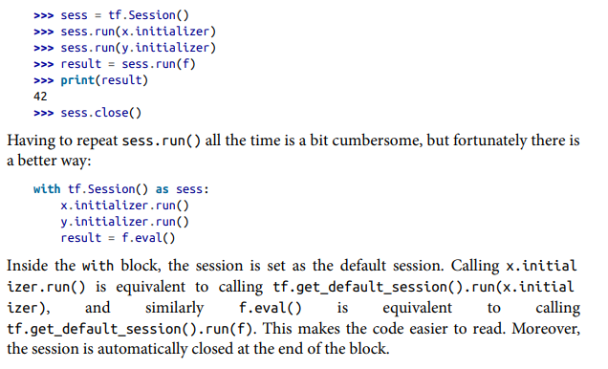

Slide 12
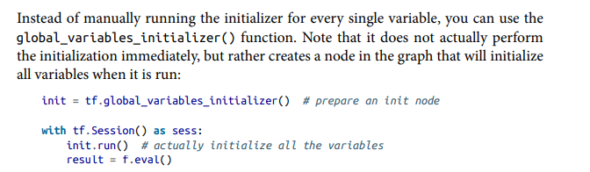

Slide 13
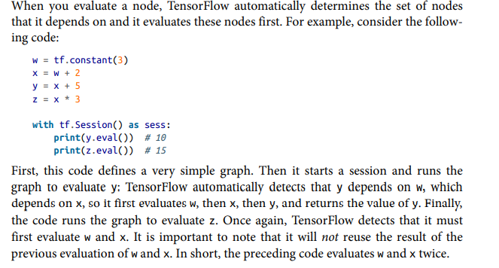
Lifecycle of a Node Value

Slide 14
Training a DNN Using Plain TensorFlow
The first step is the construction phase, building the TensorFlow graph.
The second step is the execution phase, where you actually run the graph to train the model.

Slide 15
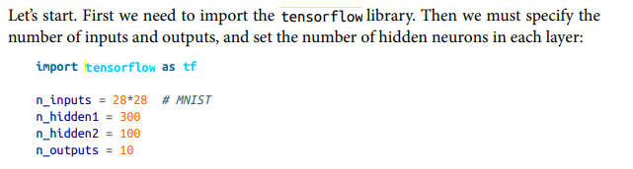
Construction Phase

Slide 16
you can use placeholder nodes to represent the training data and targets. The shape of X is only partially defined.
it will be a 2D tensor (i.e., a matrix), with instances along the first dimension and features along the second dimension, the number of features is going to be 28 x 28 (one feature per pixel), but we don’t know yet how many instances each training batch will contain.
So the shape of X is (None, n_inputs).
Similarly, we know that y will be a 1D tensor with one entry per instance, but again we don’t know the size of the training batch at this point, so the shape is (None).

Slide 17
Now let’s create the actual neural network.
The placeholder X will act as the input layer; during the execution phase, it will be replaced with one training batch at a time
Now you need to create the two hidden layers and the output layer. The two hidden layers are almost identical: they differ only by the inputs they are connected to and by the number of neurons they contain.
The output layer is also very similar, but it uses a softmax activation function instead of a ReLU activation function. So let’s create a neuron_layer() function that we will use to create one layer at a time.
It will need parameters to specify the inputs, the number of neurons, the activation function, and the name of the layer:

Slide 18

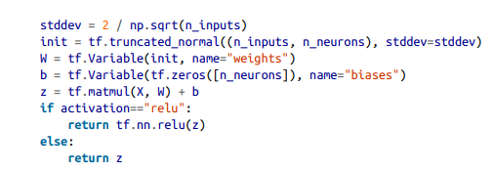

Slide 19
First we create a name scope using the name of the layer: it will contain all the computation nodes for this neuron layer. This is optional, but the graph will look much nicer in TensorBoard if its nodes are well organized.
Next, we get the number of inputs by looking up the input matrix’s shape and getting the size of the second dimension (the first dimension is for instances).

Slide 20
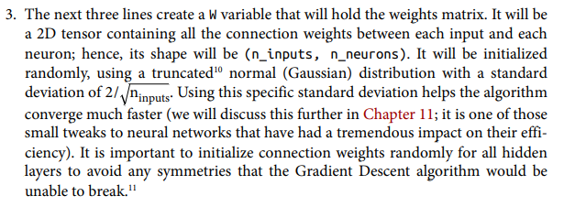
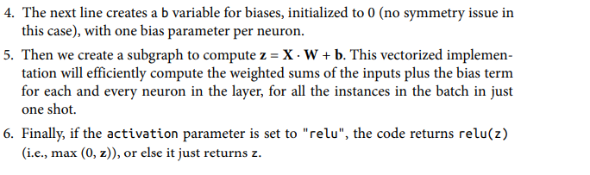

Slide 21

The first hidden layer takes X as its input.
The second takes the output of the first hidden layer as its input. And finally, the output layer takes the output of the second hidden layer as its input.

Slide 22
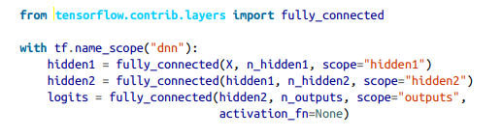
TensorFlow’s fully_connected() function creates a fully connected layer, where all the inputs are connected to all the neurons in the layer. It takes care of creating the weights and biases variables, with the proper initialization strategy, and it uses the ReLU activation function by default

Slide 23

We have the neural network model, we have the cost function, and now we need to define a GradientDescentOptimizer that will tweak the model parameters to minimize the cost function.

Slide 24
The last important step in the construction phase is to specify how to evaluate the model.
First, for each instance, determine if the neural network’s prediction is correct by checking whether or not the highest logit corresponds to the target class.
For this you can use the in_top_k() function. This returns a 1D tensor full of boolean values, so we need to cast these booleans to floats and then compute the average.
This will give us the network’s overall accuracy

Slide 25
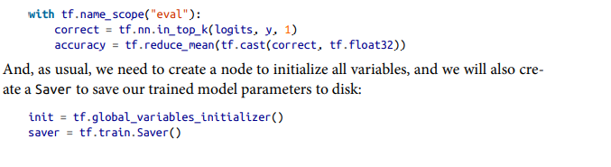

Slide 26
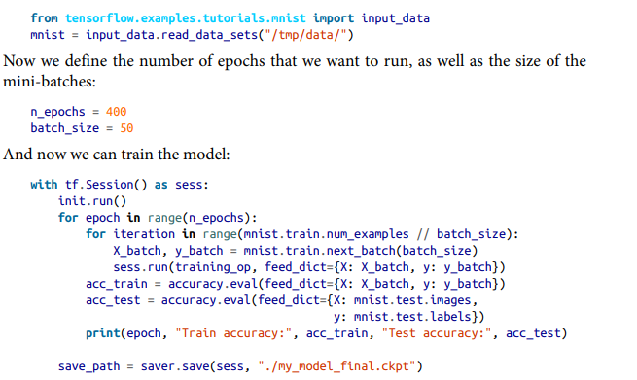
Execution Phase

Slide 27
This code opens a TensorFlow session, and it runs the init node that initializes all the variables.
Then it runs the main training loop: at each epoch, the code iterates through a number of mini-batches that corresponds to the training set size.
Each mini-batch is fetched via the next_batch() method, and then the code simply runs the training operation, feeding it the current mini-batch input data and targets.
Next, at the end of each epoch, the code evaluates the model on the last mini-batch and on the full training set, and it prints out the result. Finally, the model parameters are saved to disk

Slide 28
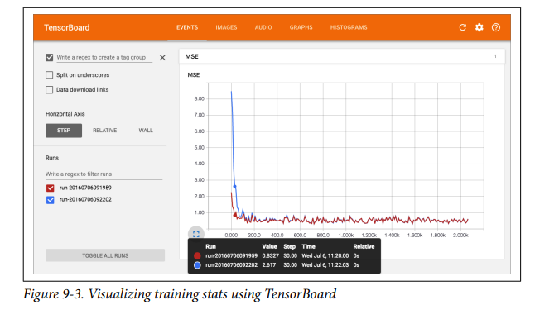
Visualizing the Graph and Training Curves Using TensorBoard

Slide 29
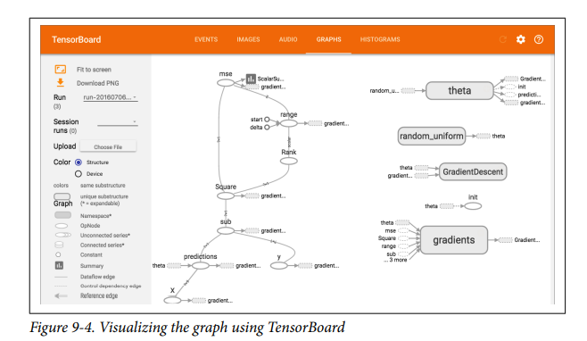

Slide 30
Implementing Batch Normalization with TensorFlow
TensorFlow provides a batch_normalization() function that simply centers and normalizes the inputs, but you must compute the mean and standard deviation and pass them as parameters to this function, and you must also handle the creation of the scaling and offset parameters (and pass them to this function)by using the batch_norm() function

Slide 31
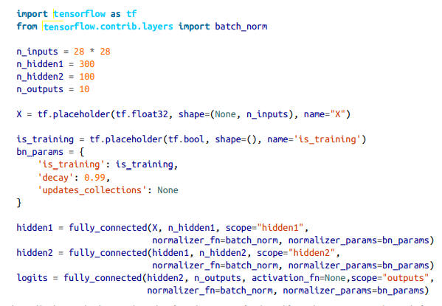

Slide 32
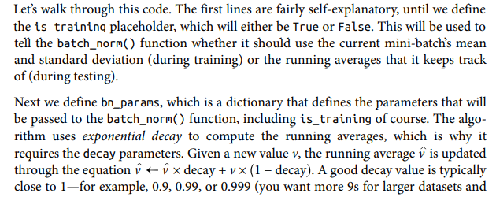
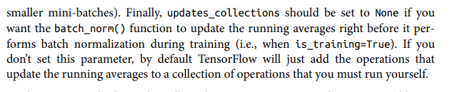

Slide 33
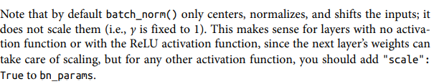

Slide 34
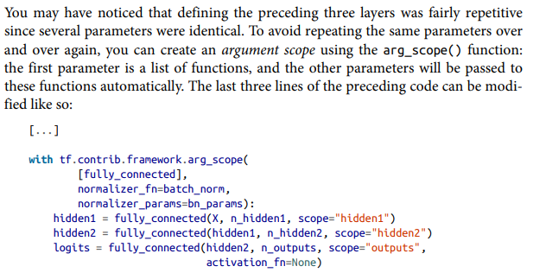

Slide 35

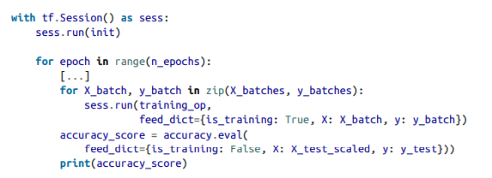

Slide 36
Batch Normalization
A batch normalization layer calculates the mean and standard deviation of each of its input channels across the batch and normalizes by subtracting the mean and dividing by the standard deviation.
There are then two learned parameters for each channel, the scale (gamma) and shift (beta).
The output is simply the normalized input, scaled by gamma and shifted by beta.

Slide 37
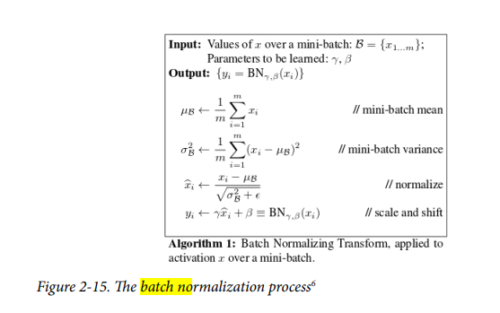

Slide 38
We can place batch normalization layers after dense or convolutional layers to normalize the output from those layers.
When it comes to prediction, we may only want to predict a single observation, so there is no batch over which to take averages.
To get around this problem, during training a batch normalization layer also calculates the moving average of the mean and standard deviation of each channel and stores this value as part of the layer to use at test time.

Slide 39
How many parameters are contained within a batch normalization layer?
  For every channel in the preceding layer, two weights need to be learned:
    the scale (gamma) and shift (beta).
    These are the trainable parameters.
    The moving average and standard deviation also need to be calculated for each channel but since they are derived from the data passing through the layer rather than trained through backpropagation, they are called nontrainable parameters.
    In total, this gives four parameters for each channel in the preceding layer, where two are trainable and two are nontrainable.

Slide 40
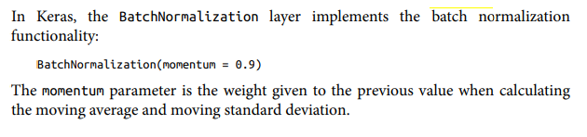

Slide 41
Dropout Layers
Any successful machine learning algorithm must ensure that it generalizes to unseen data, rather than simply remembering the training dataset.
an algorithm performs well on the training dataset, but not the test dataset, we say that it is suffering from overfitting.
To counteract this problem, we use regularization techniques, which ensure that the model is penalized if it starts to overfit.
There are many ways to regularize a machine learning algorithm, but for deep learning, one of the most common is by using dropout layers

Slide 42
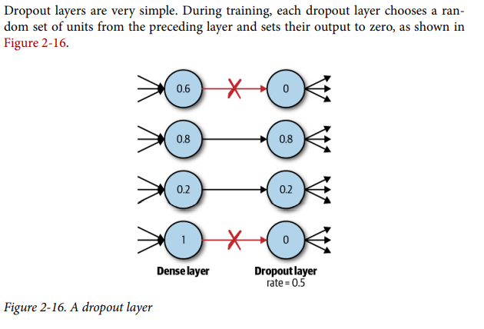

Slide 43
this simple addition drastically reduces overfitting, by ensuring that the network doesn’t become overdependent on certain units or groups of units that, in effect, just remember observations from the training set.
If we use dropout layers, the network cannot rely too much on any one unit and therefore knowledge is more evenly spread across the whole network.
This makes the model much better at generalizing to unseen data, because the network has been trained to produce accurate predictions even under unfamiliar conditions, such as those caused by dropping random units.
There are no weights to learn within a dropout layer, as the units to drop are decided stochastically.
At test time, the dropout layer doesn’t drop any units, so that the full network is used to make predictions.

Slide 44
Tensor Ranks, Shapes, and Types
TensorFlow programs use a tensor data structure to represent all data.
A tensor has a static type and dynamic dimensions.
Only tensors may be passed between nodes in the computation graph.

Slide 45
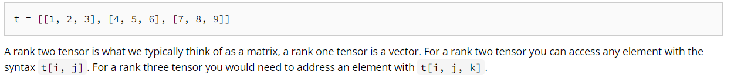
Rank
  In the TensorFlow system, tensors are described by a unit of dimensionality known as rank.
  Tensor rank (sometimes referred to as order or degree or n-dimension) is the number of dimensions of the tensor.
  For example, the following tensor (defined as a Python list) has a rank of 2:

Slide 46
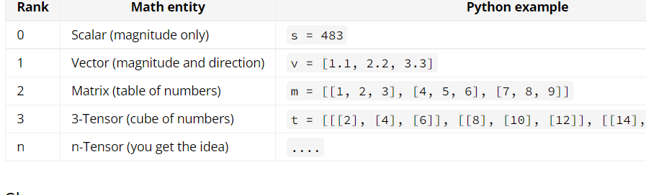

Slide 47
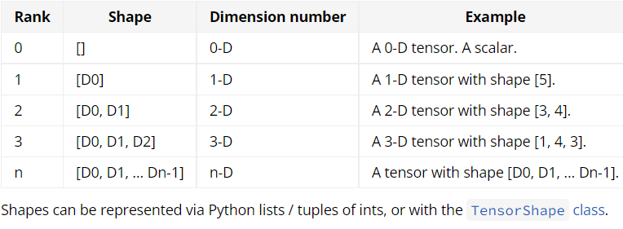
Shape
The TensorFlow documentation uses three notational conventions to describe tensor dimensionality: rank, shape, and dimension number.
The following table shows how these relate to one another:

Slide 48
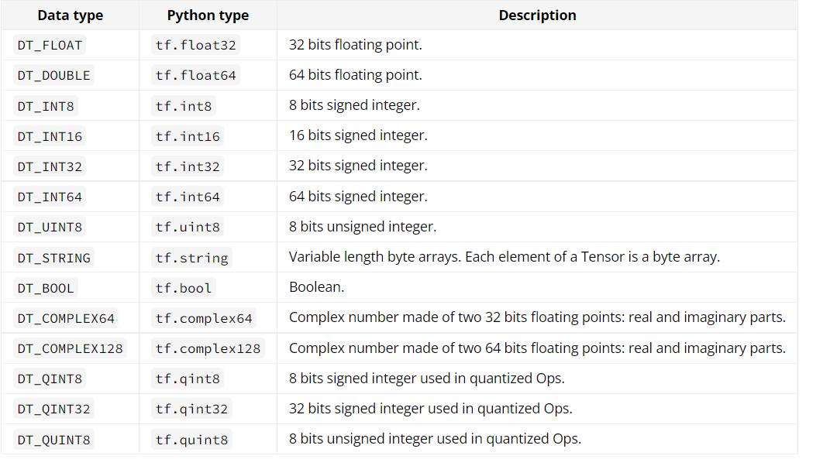
Data types

Slide 49
Introduction to keras
it is a high-level neural networks API that runs on top of TensorFlow
an end-to-end open source machine learning platform.
Using Keras, you easily define complex ANN architectures to experiment on your big data.
Keras also supports GPU, which becomes essential for processing huge amount of data and developing machine learning models.

Slide 50
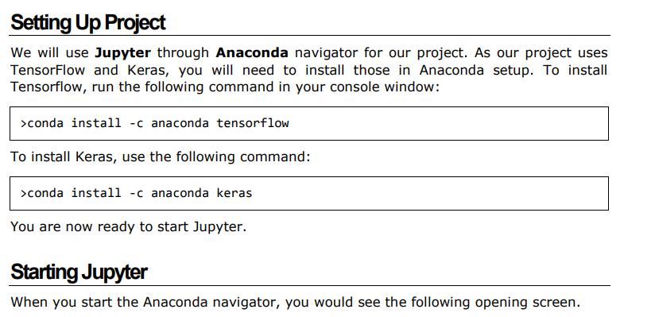

Slide 51
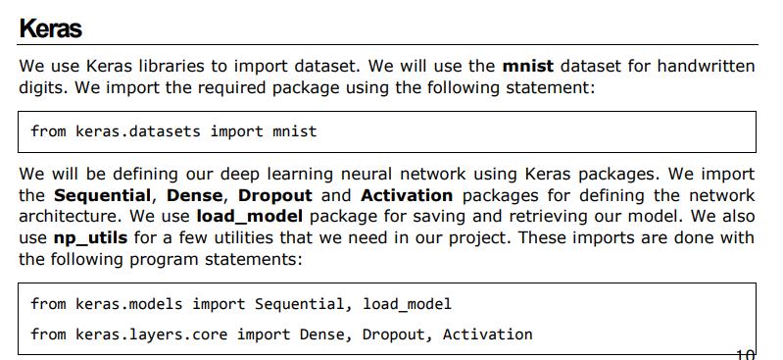
Deep Learning with Keras — Importing Libraries

Slide 52
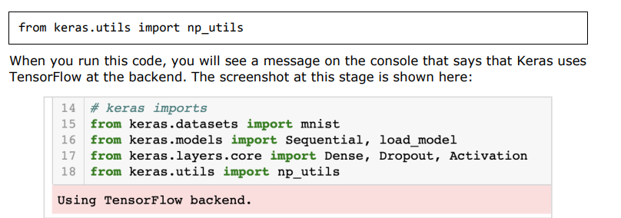

Slide 53
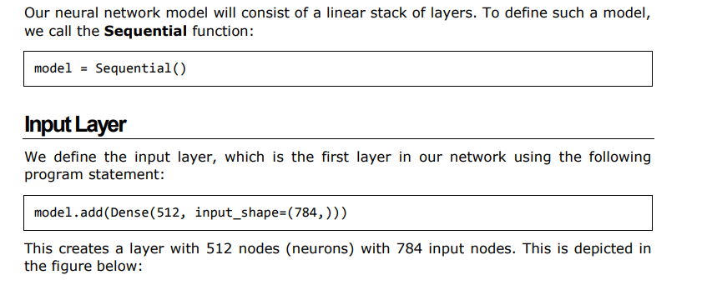
Creating Deep Learning Model

Slide 54
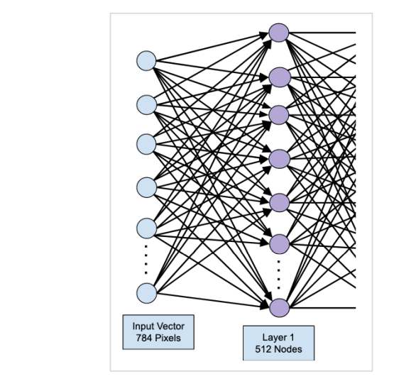
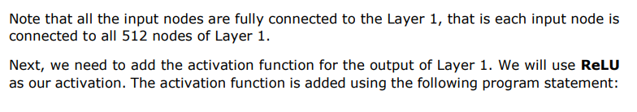

Slide 55
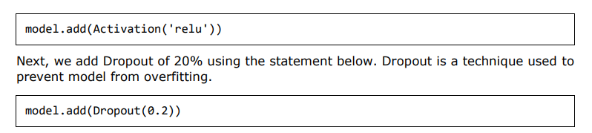

Slide 56
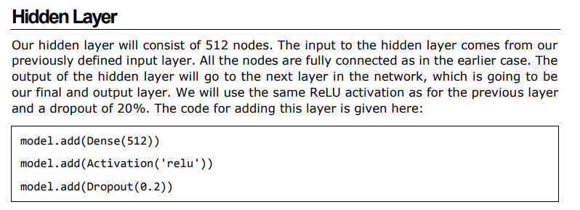
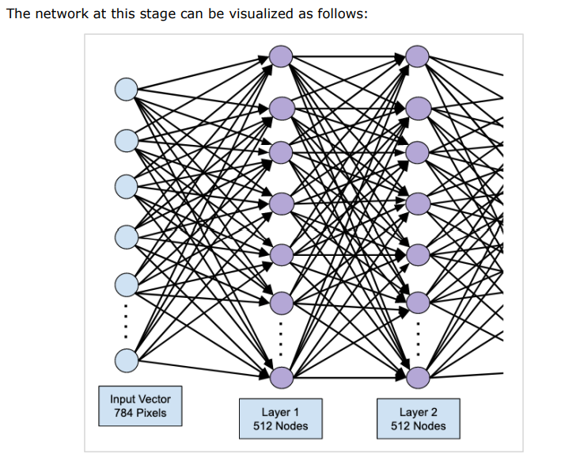

Slide 57
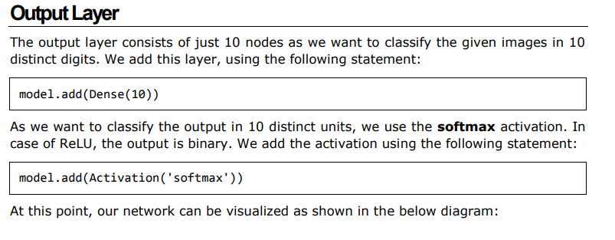
Next, we will add the final layer to our network, which is the output layer

Slide 58
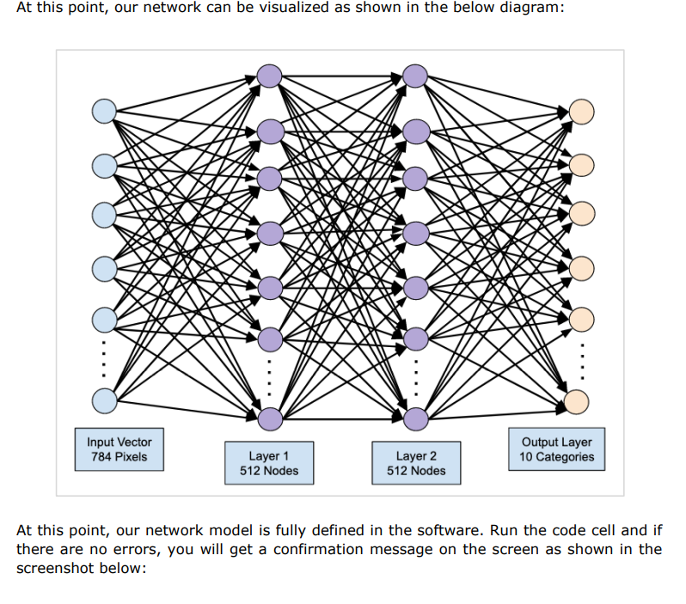
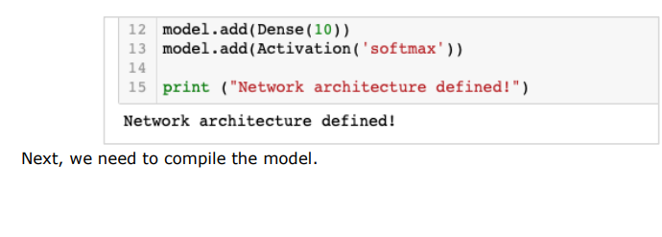

Slide 59
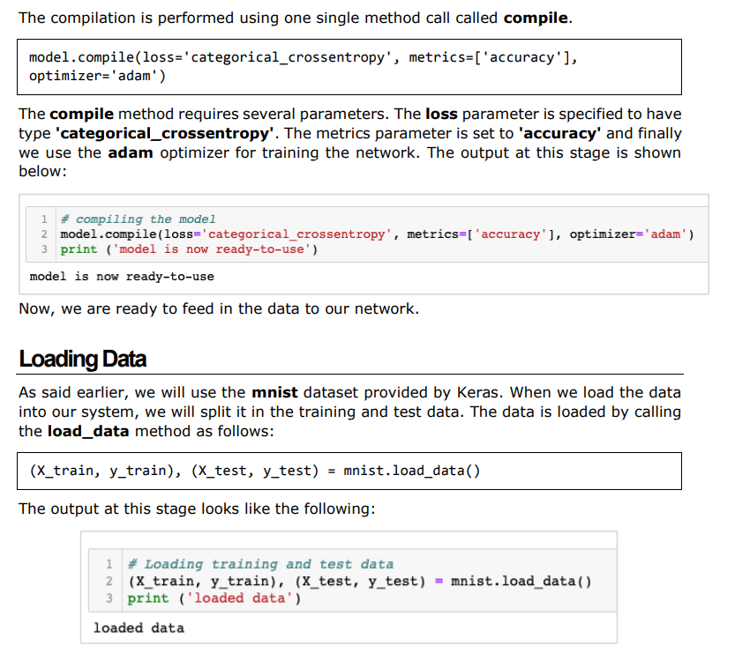
Compiling the Model

Slide 60
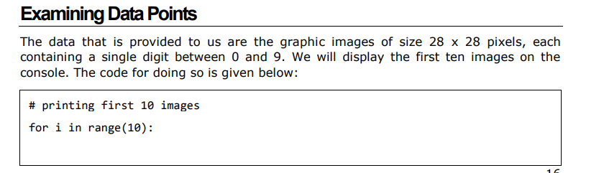
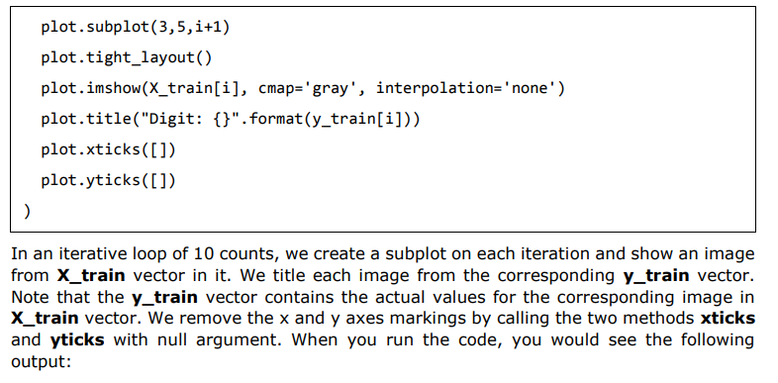

Slide 61
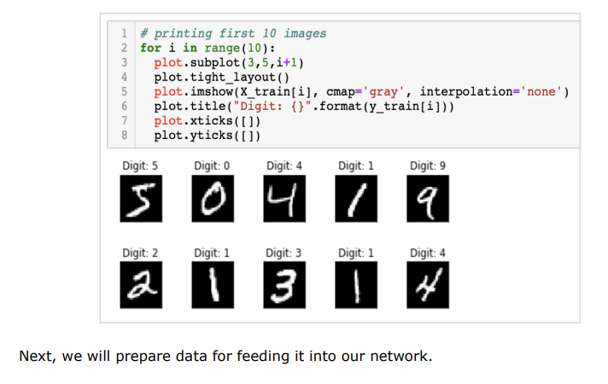

Slide 62

Preparing Data
Before we feed the data to our network, it must be converted into the format required by the network. This is called preparing data for the network.
It generally consists of converting a multi-dimensional input to a single-dimension vector and normalizing the data points.

Slide 63


Slide 64


Slide 65

Examining Data Distribution

Slide 66

Encoding Data

Slide 67


Slide 68

Training the Model

Slide 69


Slide 70

output

Slide 71

Evaluating Model Performance

Slide 72

Plotting Accuracy Metrics

Slide 73


Slide 74

Plotting Loss Metrics

Slide 75


Slide 76

Predicting on Test Data

Slide 77

Saving Model

Slide 78
Loading Model for Predictions

